Slide 1
Chapter 5
The Project in the Organizational Structure

Slide 2
Project Growth
Need for speed, market responsiveness, and product flexibility
Need for broader areas of knowledge in developing new products and services
Rapid expansion of technology
Management inability to understand and control large numbers of activities
5-<number>

Slide 3
Organizational Issues Related to Projects
How to tie project to parent firm
How to organize the project
How to organize activities common to multiple projects
5-<number>

Slide 4
Traditional Forms of Organization
Functional
Projectized
Matrix
Composite
5-<number>

Slide 5
Projects in a Functional Organization
Make it a part of one of the functional divisions
  More than one choice may exist
  If support from other areas is needed, they are expected to help support the project
Another way is to assign the work to all divisions with the top management overseeing the effort
5-<number>

Slide 6
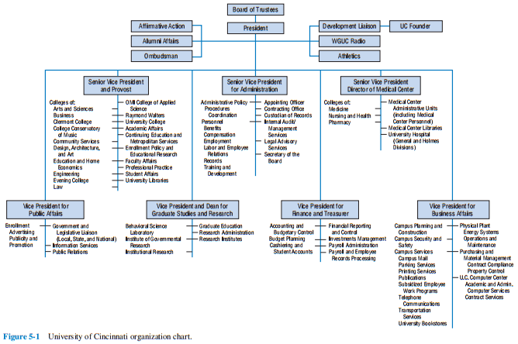
Including Project In Traditional Forms
5-<number>

Slide 7
Advantages
Maximum flexibility in the use of staff
Experts can be utilized by many different projects
Specialists can be grouped to share knowledge and experience
Functional division serves as a base of technological continuity
Functional division contains the normal path of advancement
5-<number>

Slide 8
Disadvantages
Client is not the focus of the activity
Functional units tend to be oriented toward the activities of that particular function
No individual is given full responsibility
Response to client needs is slow and arduous
Tendency to suboptimize the project
Motivation tends to be weak
A holistic approach to the project is not facilitated
5-<number>

Slide 9
Projects in a Projectized Organization
Projects have a full compliment of functions
Each project is stand-alone
5-<number>

Slide 10
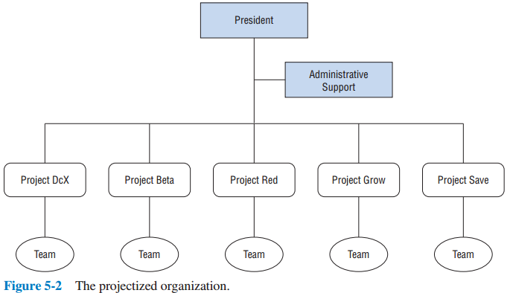
Projects in a Projectized Organization
5-<number>

Slide 11
Advantages
Project manager has full authority
All members report to the project manager
Short lines of communication
When there are similar projects, expertise can be retained
Strong and separate identity
Swift decisions
Unity of command
Structurally simple and flexible
Supports a holistic approach
5-<number>

Slide 12
Disadvantages
Duplication in staffing
Stockpiling
Workers tend to fall behind in other areas of their technical expertise
Inconsistency in policies and procedures
A project takes on a life of its own
Worry about life after the project is over
5-<number>

Slide 13
Projects in a Matrixed Organization
It is a combination of standalone projectized and functional organization structures
Matrixed project organization
  Keeps desirable features of both standalone and functional projects
  Avoids some of the disadvantages of each type
Can take on a variety of specific forms
  From strong to weak
5-<number>

Slide 14
Strong Matrix
The project manager may report to a program manager, or a functional manager
Control
  PM controls when and what employees assigned to them do
  Functional managers control
    who will be assigned to the project
    how the work will be done
5-<number>

Slide 15
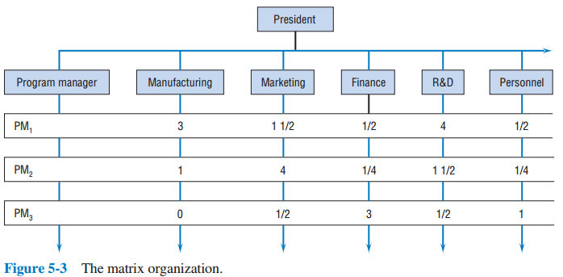
Strong Matrix
5-<number>

Slide 16
Weak Matrix
Project might have only one full-time person, the project manager
Functional departments devote capacity to the project
Primary task of the project manager is to coordinate project activities carried out by the functional departments
5-<number>

Slide 17
Balanced Matrix
It is in between the weak and strong matrix
May not be evenly balanced between them
5-<number>

Slide 18
Matrix Structure Advantages
The project is the point of emphasis
The project has access to the entire organization for labor and technology
Less anxiety about what happens when the project is completed
Response to client needs is rapid
Access to administrative units of firm
Better balance of resources
Great deal of organizational flexibility
5-<number>

Slide 19
Matrix Structure Disadvantages
Power balance is delicate
Projects compete for resources
Projectitis is still a serious disease
Division of authority and responsibility is complex
Matrix management violates the management principle of unity of command
5-<number>

Slide 20
Virtual Projects
Project team crosses time, space, organizational, or cultural boundaries
Facilitated by the use of the Internet
Often organized as a matrix
5-<number>

Slide 21
Virtual Project Rules For Success
Challenging and interesting projects
Use volunteers
Include some people who know each other
Create an online resource to learn about each other
Encourage frequent communication
Divide work into independent modules
5-<number>

Slide 22
Projects in Composite Organizational Systems
We often see combinations of the previous forms
May spin off successful, long-term projects as subsidiaries
Venture team/firm
Composite form leads to flexibility
5-<number>

Slide 23
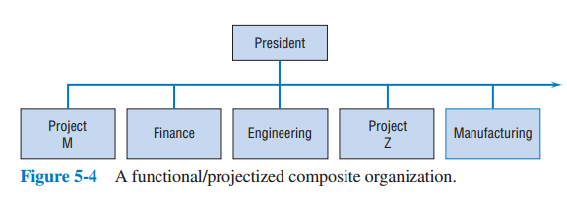
Projects in Composite Organizational Systems
5-<number>

Slide 24
Selecting a Project Form
Firms typically do not set out to pick an organizational form
Rather, the structure evolves over time
The structure is not static
Rather, it changes as the organization, its goals, and its environment changes
5-<number>

Slide 25
Functional Form Best for…
In-depth application of a technology
Large capital investment, especially when that investment is concentrated in one functional area
5-<number>

Slide 26
Project Form Best for…
Handling a large number of similar projects
Handling a one-time project that requires much control, but is not focused on one functional area
5-<number>

Slide 27
Matrix Form Best for…
Projects that require inputs from several functional areas
Projects that use technology from several functional areas
5-<number>

Slide 28
The Project Management Office (PMO)
No project has ever been completed precisely as it was planned
Successful execution of a project is a complex managerial task
  Requires the use of planning, budgeting, scheduling, and control tools
  Contractual, administrative, and reporting duties must be performed in accord with the law
60% of organizations have PMOs
5-<number>

Slide 29
Purposes of the PMO
Establish project administrative procedures
Ensures the firm’s project portfolio supports its overall goals and strategies
Gradual assimilation of project management practices into the entire firm
Facilitator of projects, not the doer of projects
5-<number>

Slide 30
Forms of PMO
Information center
Establish procedures and practices
Establish a resource database and monitor inter-project dependencies
5-<number>

Slide 31
Tasks of the PMO (Slide 1 of 2)
Establish and enforce good practices
Improve maturity
Improve project management systems
Offer training
Help with administrative details
Establish a process for dealing with risk
Determine if a project is a good fit
Identify impact of changes on projects
5-<number>

Slide 32
Tasks of the PMO (Slide 2 of 2)
Conduct project reviews and audits
Maintain and store project archives
Serve as a champion to pursue project management
Serve as a home for project managers
Collect and disseminate lessons learned
Assist in project closure
5-<number>

Slide 33
Project Management Maturity
Project management competency is one of the key factors in project management success
Includes the standardization of project management techniques
5-<number>

Slide 34
Project Management Maturity Levels
Initial – no formal process
Repeatable – procedures in place for planning, scheduling, tracking, and estimating
Defined – the firm has integrated system for tracking and managing, but they are not routinely used or understood
Managed – systems are installed and used
Optimizing – integrated databases used to track historical projects to help obtain continuous improvement
5-<number>

Slide 35
Five Steps for PMO Success
Identify quantifiable measures to prove accomplishments
Set a realistic time frame for results
Have resources needed to achieve goals
Establish credibility throughout the organization
Get the best people for the PMO
5-<number>

Slide 36
The Project Team
Systems architect
Development engineer
Test engineer
Contract administrator
Project controller
Support services manager
5-<number>

Slide 37
Human Factors & Project Team (Slide 1 of 2)
All projects are composed of inter-connected groups
These groups can form teams
It is not enough to have an effective team
The team must also be working towards the good of the project
Need to avoid “us versus them” mentality
5-<number>

Slide 38
Human Factors & Project Team (Slide 1 of 2)
Some of the problems that prevent a team from performing effectively:
  Internal conflict
  Member frustration
  Wasting time
  Poor decision making
  Team members are more concerned with finishing the job than doing a good job
Project teams need to work together
5-<number>

Slide 39
Participative Management
Individual workers should play a role in how work is accomplished
This empowers the team
Advantages of empowerment:
  Harnesses ability of team
  Professionals don’t like micromanagement
  Team members know they are accountable
  Synergy
  Team members get timely feedback
  PM given tool to evaluate team’s performance
5-<number>

Slide 40
Copyright
Copyright © 2018 John Wiley & Sons, Inc.
All rights reserved. Reproduction or translation of this work beyond that permitted in Section 117 of the 1976 United States Act without the express written permission of the copyright owner is unlawful. Request for further information should be addressed to the Permissions Department, John Wiley & Sons, Inc. The purchaser may make back-up copies for his/her own use only and not for distribution or resale. The Publisher assumes no responsibility for errors, omissions, or damages, caused by the use of these programs or from the use of the information contained herein.
Copyright ©2018 John Wiley & Son, Inc.

